Slide 1
E-R Diagram Examples
Rushali Patil

Slide 2
E-R Example Simple University Database
In our database, we have students. They have a name, a registration number, and a course of study.
The university offers lectures. Each lecture may be part of some course of study in a certain semester. Lectures may have other lectures as prerequisites. They have a title, provide a specific number of credits and have an unique ID
Each year, some of these lectures are offered by a professor at a certain day at a fixed time in a specific room. Students may register for that lecture.
Professors have a name and are member of a specific department.

Slide 3
Identify Entities
In our database, we have students. They have a name, a registration number, and a course of study.
The university offers lectures. Each lecture may be part of some course of study in a certain semester. Lectures may have other lectures as prerequisites. They have a title, provide a specific number of credits and have an unique ID
Each year, some of these lectures are offered by a professor at a certain day at a fixed time in a specific room. Students may register for that lecture.
Professors have a name and are member of a specific department.

Slide 4
Identify attributes
In our database, we have students. They have a name, a registration number, and a course of study.
The university offers lectures. Each lecture may be part of some course of study in a certain semester. Lectures may have other lectures as prerequisites. They have a title, provide a specific number of credits and have an unique ID
Each year, some of these lectures are offered by a professor at a certain day at a fixed time in a specific room. Students may register for that lecture.
Professors have a name and are member of a specific department.

Slide 5
Solution
Registration Number
Title
Professor
ID
Credits
Student
Name
Lecture
Prerequisite Lecture
Department
Name
Course of Study
Course of Study
Curriculum
Name
Semester

Slide 6
Problems
“Course of study” does not seem to be an attribute
“Prerequisite lecture” also is not a good attribute
“Professor” does not have key attributes

Slide 7
Solution 1
Teaches
PID
Title
ID
Credits
Registration Number
Professor
Lecture
Attend
Prereq
Student
Name
Enrolls
Parts of
Department
Name
Course of Study
Curriculum
Name
Semester

Slide 8
Problem
Each year, some of these lectures are offered by a professor at a certain day at a fixed time in a specific room. Students may register for that lecture.

Slide 9
Solution 1
Teaches
Room
Time
Date
PID
Attend
Offered Lectures
Registration Number
Credits
Professor
Has
Title
Prereq
Lecture
Name
Student
ID
Enrolls
Parts of
Department
Name
Course of Study
Curriculum
Name
Semester

Slide 10
Final Solution
Teaches
Room
Time
Date
PID
Attend
Offered Lectures
Registration Number
Credits
Professor
Has
Title
Prereq
Lecture
Name
Student
ID
Enrolls
Parts of
Department
Name
Course of Study
Curriculum
Name
Semester

Slide 11
E-R Example –Artbase Gallery
Draw E-R Diagram for:
Galleries keep information about artists, their names (which are unique), birthplaces, age,and style of art.
For each piece of artwork, the artist, the year it was made, its unique title, its type of art (e.g., painting, lithograph, sculpture, photograph), and its price must be stored.
Pieces of artwork are also classified into groups of various kinds, for example, portraits, still lifes, works by Picasso, or works of the 19th century; a given piece may belong to more than one group.
Each group is identified by a name (like those just given) that describes the group.
Finally, galleries keep information about customers. For each customer, galleries keep that person’s unique name, address, total amount of dollars spent in the gallery (very important!), and the artists and groups of art that the customer tends to like.

Slide 12
Solution
year
type
name
title
price
Like_Group
Classify
Group
Artwork
Like_Artist
Paints
Customer
Artist
address
style
cust_id
name
amount
birthplace
age
name

Slide 13
E-R Example For airline reservation system
Design an ER diagram for an airline reservation system:
The database represents each Airport, keeping its unique Airport Code, the Airport Name, and the City and State in which the Airport is located.
Each airline flight has a unique number, the Airline for the flight, and the Weekdays on which the flight is scheduled.
A flight is composed of one or more flight legs. Each flight leg has a leg number, Departure airport and Scheduled Departure Time, and an arrival airport and Scheduled Arrival Time.
A leg instance is an instance of a flight leg on a specific date. The Number of available seats and the airplane used in the leg instance are also kept.
The customer reservations on each leg instance include the customer name, phone, and seat numbers for each reservation.
Information on Airplanes and Airplane Types are also kept. For each Airplane type the Type Name, manufacturing company, and maximum number of seats are kept. The Airports in which planes of this type Can Land are kept in the database. For each Airplane, the Airplane Id, Total number of seats, and Type are kept.

Slide 14
Identify Entities
Design an ER diagram for an airline reservation system:
The database represents each Airport, keeping its unique Airport Code, the Airport Name, and the City and State in which the Airport is located.
Each airline flight has a unique number, the Airline for the flight, and the Weekdays on which the flight is scheduled.
A flight is composed of one or more flight legs. Each flight leg has a leg number, Departure airport and Scheduled Departure Time, and an arrival airport and Scheduled Arrival Time.
A leg instance is an instance of a flight leg on a specific date. The Number of available seats and the airplane used in the leg instance are also kept.
The customer reservations on each leg instance include the customer name, phone, and seat numbers for each reservation.
Information on Airplanes and Airplane Types are also kept. For each Airplane type the Type Name, manufacturing company, and maximum number of seats are kept. The Airports in which planes of this type Can Land are kept in the database. For each Airplane, the Airplane Id, Total number of seats, and Type are kept.

Slide 15
Identify Attributes
Design an ER diagram for an airline reservation system:
The database represents each Airport, keeping its unique Airport Code, the Airport Name, and the City and State in which the Airport is located.
Each airline flight has a unique number, the Airline for the flight, and the Weekdays on which the flight is scheduled.
A flight is composed of one or more flight legs. Each flight leg has a leg number, Departure airport and Scheduled Departure Time, and an arrival airport and Scheduled Arrival Time.
A leg instance is an instance of a flight leg on a specific date. The Number of available seats and the airplane used in the leg instance are also kept.
The customer reservations on each leg instance include the customer name, phone, and seat numbers for each reservation.
Information on Airplanes and Airplane Types are also kept. For each Airplane type the Type Name, manufacturing company, and maximum number of seats are kept. The Airports in which planes of this type Can Land are kept in the database. For each Airplane, the Airplane Id, Total number of seats, and Type are kept.

Slide 16
Identified Entities
Airport
Airplane Type
Airplane
Flight leg
Flight
Leg Instance
Reservation

Slide 17
Solution
Airline Reservation System.docx
Airline Reservation System 1.docx
Airline Reservation System 2.docx

Slide 18
E-R Example For Banking Database
The bank is organised into branches. Each branch is located in a particular city and is identified by a unique name. The bank monitors the assets of each branch.
Bank customers are identified by their customer_id value. The bank stores each customer’s name, and the street and the city where the customer lives. Customers may have accounts and can take out loans. A customer may be associated with a particular banker; who may act as a loan officer or personal banker for that customer.
The bank offers two types of accounts: savings and checking accounts. Accounts can be held by more than one customer, and a customer can have more than one account. Each account is assigned a unique account number. The bank mantains a record of each account’s balance and the most recent date on which the account was accessed by each customer holding the account. In addition each savings account has an interest rate, and overdrafts are recorded for each checking account.
The bank provides its customers with loans. A loan originates at a particular branch and can be held by one or more customers. A loan is identified by unique loan number. For each loan, the bank keeps track of loan amount and the loan payments. Although a loan-payment number does not uniquely identify a particular payment among those for all the bank’s loans, a payment number does identify a particular payment for a specific loan. The date and the amount are recorded for each payment.
Bank employees are identified by their employee_id values. The bank administration stores the name and telephone number of each employee, the names of the employee’s dependents, and the employee_id number of the employee’s manager. The bank also keeps track of the employee’s start date and, thus, length of employment.

Slide 19
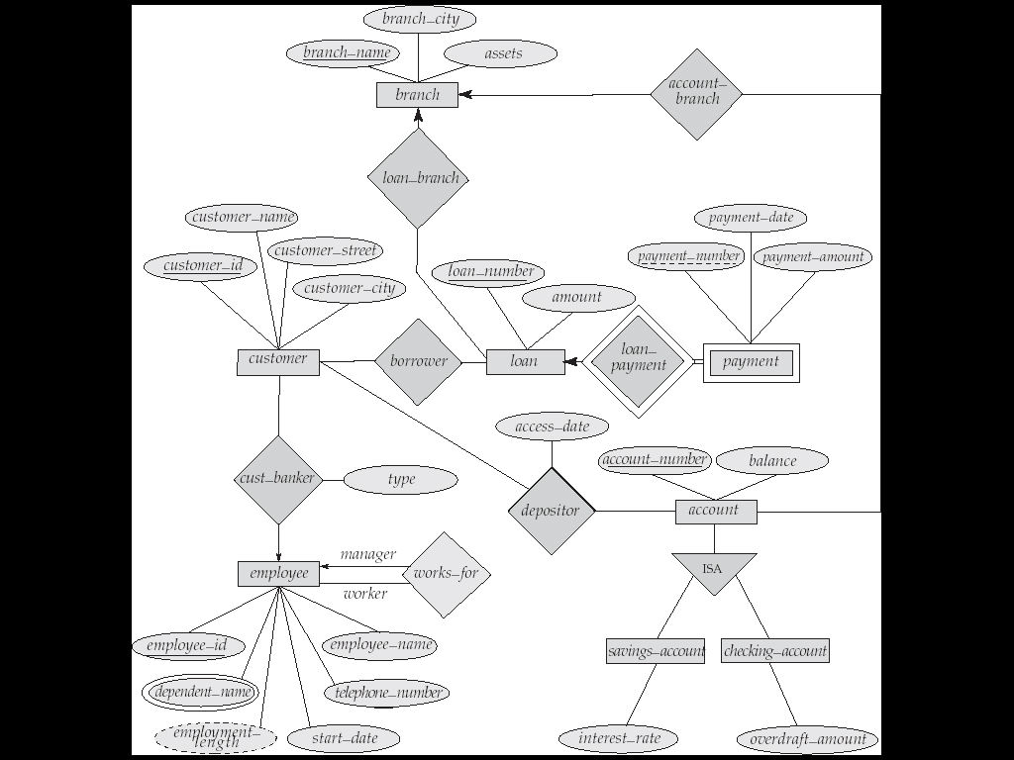
E-R Example For Banking Database

